Slide 1
Welcome To York Code Dojo
David Betteridge @da_betteridge
Yorkdevelopers.org
@yorkdevelopers
@yorkcodedojo

Slide 2
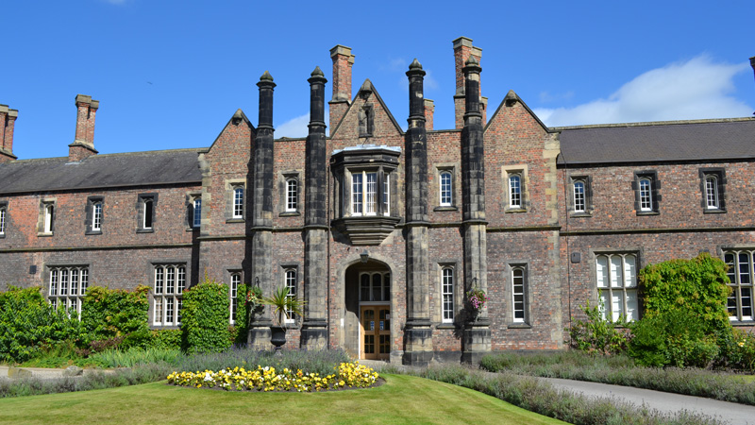
Notes:
Thank to York St John for the room and food
Student placements
Mentoring

Slide 3
Agenda
Quick Introduction
Explain the problem
Work in pairs till 8.45pm
Opportunity to show off solutions
Pub about 9pm

Slide 4

Code Dojo
Notes:
Aim for tonight isn’t to get a job, but to learn something news.
Who has been to a code dojo before?
What is the point?
It’s a place to practice coding safely. By that we mean it doesn’t matter if you haven’t solved the problem by the end of the evening. No one will judge you on it. It’s a place to practice, learn and try out new things.
For example you could use a language you have never used before, partner with someone new, try a different approach to solving the problem. You could add your own constraints; like my functions won’t have more than three lines; or I’m not going to use any IF statements.
(It’s also meant to be fun) It’s driving a car to work every day, you might cover a lot of miles, but if you are doing the same journey then does your driving ability really improve?
It’s driving a car to work every day, you might cover a lot of miles, but if you are doing the same journey then does your driving ability really improve?

Slide 5
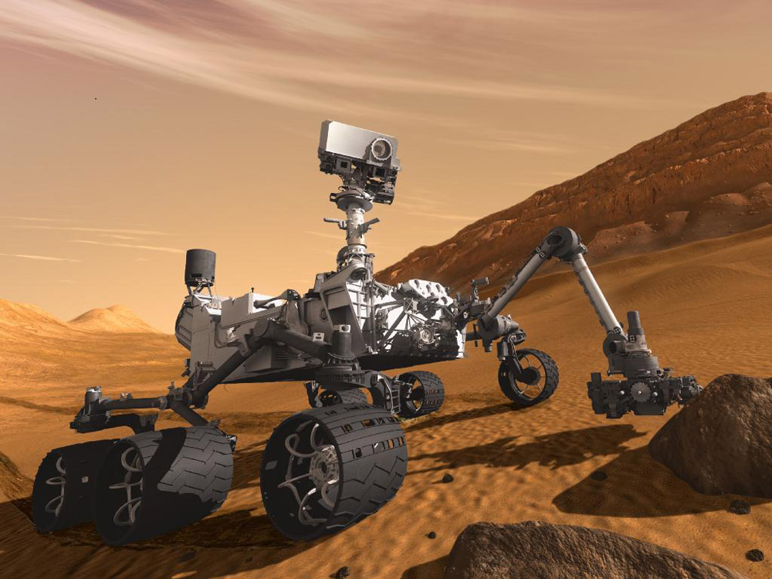

Slide 6
A Mars Rover has been developed to map out the landscape.
It's a small robot which can move on a grid, controlled by simple commands.
In this example, it will move on a 5x5 grid with a simple co-ordinate system - 0,0 is the bottom left, 4,4 is the top right.
We can control the Rover by sending it a string consisting of commands, such as the following:
RFLFFRFR
means rotate right 90 degrees,
L rotate left 90 degrees,
and F means move forward one square in the direction the Rover is currently facing.
The Rover starts at 0,0 facing North ("up" the grid).
We need a program which will accept strings of commands at the command line, and return the grid position of the Rover after those commands

Slide 7
Aims
Use TDD
Remember to refactor
The Mars Rover costs a lot of money. Your program must work.
I may throw in a new requirement

Slide 8
York Developers include…
Games Developers (3rd Thursday of the month)
Code and Coffee (Monday and Wednesday mornings)
Agile York (3rd Wednesday of the month)
Dot Net York (1st Tuesday of the month)
And more

